Slide 2
Roots and definition
Dewey’s and Kilpatrick’s progressive philosophy of education.
the educational project is a theoretical construct which does imply a teaching methodology and a specific curricular approach based on integration, student-centred teaching and learning and active participation, learning being related to the concrete action on social/physical level

Slide 3
The problem....
Is it possible to use the Project Method and the concept of Leaning by Doing to develop 21 Century skills and to foster inclusion?
If yes,
how should we do it?
and
what are the tools and methods we need?

Slide 4
Who should establish the Project Goal?
Building upon Dewey’s ideas ,the project goal is the student’s response to a real world problem
This brings us outside the classroom to the social or phisical world phenomen
The students should choose the problem after a research in the real world and properly group deliberation and critical thinking

Slide 5
When and how comes the Learning?
The projects goal is not learning, it is changing the reality. Learning is the teacher’s objective
Learning is related to the student’s action at ontological level according to the project goal.
Learning is the result of the reflection on the actions carried out on ontological level and the psychical phenomena that is correlated to them (Learning by doing)
Learning emerges during the implementation of the project and is highlighted by specific reflection activities facilitated by the teacher

Slide 6
How can the teacher facilitate learning?
By highlighting psychical phenomena (perception, impressions, emotions and feelings) that is correlated to the project activities
Using specific reflection activities: whole class and group discussions, student journals, essays

Slide 7
PBL
The project method implies an interactive, non-formal teaching methodology based on student cooperation and the dialog between teacher and students.

Slide 8
The Project Method in Social Studies and Citizenship Education
applying the project method is relatively simple, since we can rebuild a social reality in the classroom or interact with social phenomena in the „real” world
Examples: public policy projects, community development projects, community service projects, election projects....

Slide 9
Steps for the Project Method 1,2
students have to observe the physical and social environment and find relevant local community problems/needs;
The students have to interact and choose one relevant problem for each project group. The teacher facilitates this project, but does not manipulate the students!

Slide 10
Steps for the Project Method 3
The students have to interact with main community actors to gather information and support and also to consult other sources of information, the media and the WWW in order to describe their problem as good as possible and to develop a solution to the.

Slide 11
Steps for the Project Method 4,5
The students investigate possible alternative solutions and highlight their positve and negative aspects
The students develop their own solution to the problem and present it as vivid as possible highlighting the advantages, bringing social, econinomical arguments....

Slide 12
Steps for the Project Method 6
6. Make a project presentation in order to gain support for the project...
Several means to do this:
Use PP
Use Blogs
Use Facebook
Use local media and the WWW
...............................................

Slide 13
At this point the project can take 2 diffrent routes.....
Advocacy / lobby projects: the students develop and carry out an advocacy plan in order to influence local authorities or stakeholders to implement the proposed solution. Students activity = implementing an advocacy plan
Social action /community service projects: the students find support from other students, or community members, gather funds and resources and implement the solution by themselves

Slide 14
Social action /community service projects:
After choosen the project goal, related to the problem to solve students will brainstorm for additional problems and draft a problem tree:
Main problem
Additional problem 1
Additional problem 2
Additiona problem 3

Slide 15
Main problem
Additional problem 1
Additional problem 2
Additiona problem 3
Activity 1
Activity 2
Activity 3
Resources
Resources
Resources

Slide 16
What students and community gains...
Solving problems with their own power gives students the confidence of their strength as a group and leads to social inclusion.
During this process differences between students will lead to different roles in the project which should make them be viewed as individual strengths.
Finding support from community members, authorities, NGO-s will also increase social participation and contribute to community development
Learning will result trough a reflection on these experiences carried out individually and in participative reflection groups.

Slide 17
Final recommandations
The students decide the project goal and how to carry out the project, the teacher might facilitate this process
The studens work in small groups, or in pairs
The project is the process, not only the final presentation, the panel etc, the project is to whole learning experience genereted by the process
The project should be followed by an whole group reflection activity (it is learning by doing...)

Slide 18
WISH PROJECT – TEACHING TRAINING ACTIVITIES

Slide 19
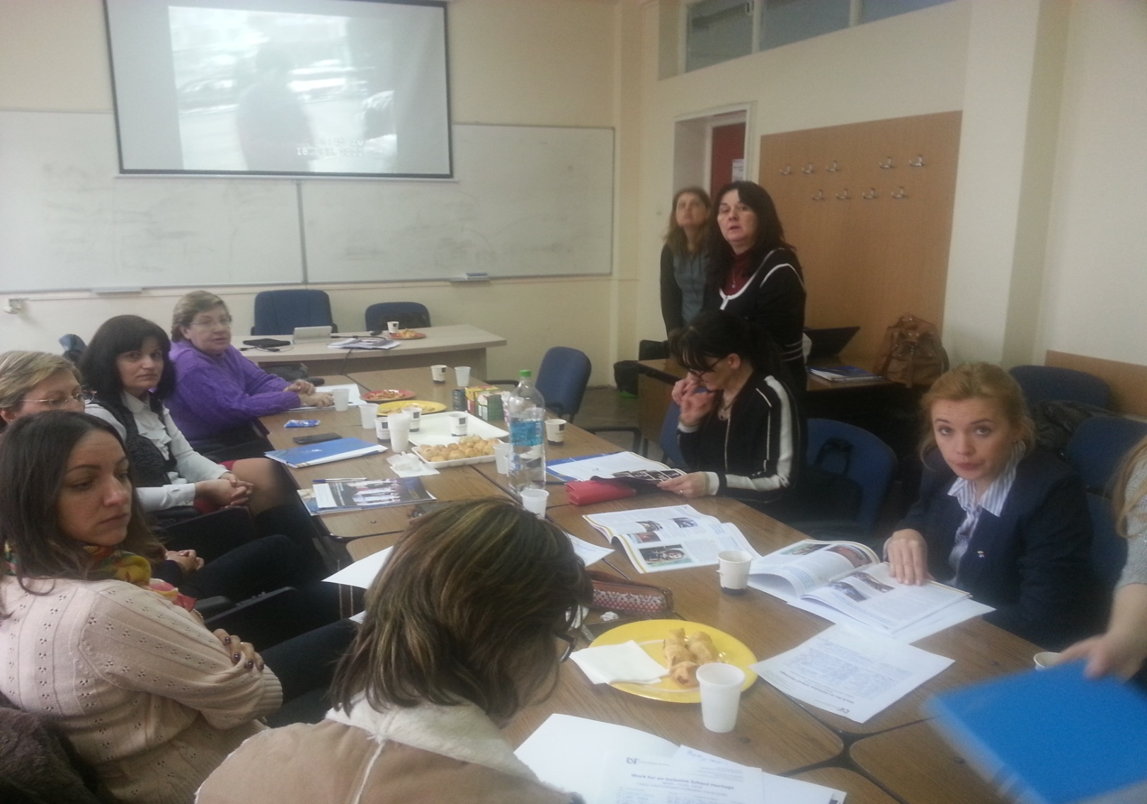
WISH PROJECT – TEACHING TRAINING ACTIVITIES

Slide 20
WISH PROJECT – TEACHING TRAINING ACTIVITIES

Slide 21
WISH PROJECT – TEACHING TRAINING ACTIVITIES

Slide 22
Thank you

